Slide 1
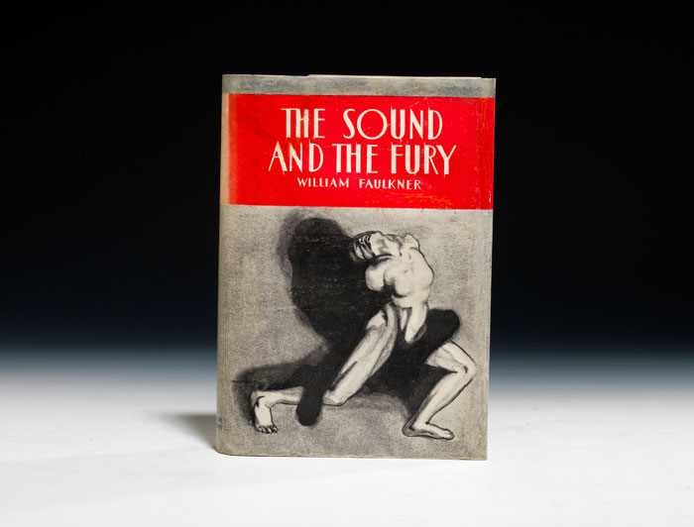
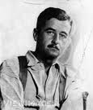
THE SOUND AND THE FURY

Slide 2
Stream Of Consciousness
The term "stream-of-consciousness" refers to a technique of narration. Prior to the twentieth century, an author would simply tell the reader what one of the characters was thinking. Stream-of-consciousness is a technique whereby the author writes as though inside the minds of the characters.

Slide 3

This novel has four narrators and we’ll discuss different perspectives :
First, Benjy Compson.
Second, Quentin Compson.
Third, Jason Compson.
Fourth, Dilsey Compson.

Slide 4

Benjy Compson
Benjy's description as the first-person narrator.
For the most part, his language is simple-sentences are short, vocabulary basic the idiot has no concept of time or place-sensory stimuli in the present bring him back to another time and place in his past, instantly and without warning.
many of Benjy’s recollections are of their early childhood.
Benjy records mainly sensual impressions.

Slide 5

He suffered from a strange sense of timelessness, in which the slightest sensory impulse could trigger vivid memories from his past and he seemed to "relive" those memories as if they were still happening.
Benjy cannot understand any abstract concepts such as time, cause and effect, or right and wrong - he merely absorbs visual and auditory cues from the world around him.
Benjy does have an acute sensitivity to order and chaos, and he can immediately sense the presence of anything bad, wrong, or out of place. He has no capacity for subjective thought.

Slide 6

)
Revelations to “self and family”
Most of Benjy’s other memories also focus on Caddy, who alone among the Compsons genuinely cared for Benjy. Key memories regarding Caddy include a time when she uses perfume (1905), when she loses her virginity (1909), and her wedding (1910). Benjy also recalls his name change (from Maury to Benjamin) in 1900, his brother Quentin’s suicide in 1910, and the sequence of events at the gate which lead to his being castrated, also in 1910.

Slide 7

Effect of narrative style on the reader
Reading this first section of The Sound and the Fury is very profoundly difficult to navigate. Benjy is one of the most incomprehensible and challenging narrators in all of literature. When he shifts from the past tense to the present, he gets you confused and not concentrated.

Slide 8

n
Quentin Compson
The second section recounts the story from Quentin
Compson’s perspective.
In the Quentin section, everything is presented through random ideas connected by association. Moreover, we find long, complex, and difficult ideas. Quentin's mind is a more advanced mind and his thoughts jump from one idea to another very quickly. Therefore, Quentin's mind is concerned only with one or two ideas the dishonor of his sister Caddy and the nihilistic philosophy of his father.

Slide 9
Revelations to “self and family”
In a simply words he is He is a very intelligent and sensitive young man. Quentin feels pride in his family’s noble and glorious past, but he recognizes that today nothing remains of that past " it is mere shadow ". He would to reveal his family though his idealistic world such as honor, virtue, and feminine purity. But when he finds that his sister and father have disregarded the code that gives order and meaning to his life, he is driven to despondency and eventually suicide by drowning himself in the Charles River.

Slide 10
Effect of narrative style on the reader
He used a present-day setting in order to expose a certain message that is going around his family's story . Therefore, he wanted us to know that these issues could happen everywhere at any time.

Slide 11

Jason Compson
1- well-spoken , his section is filled mostly by quotations of other , reinforcing the idea that he focuses his hatred on the entire world although subconscious .

Slide 12
2 - In Jason's chapter the antagonist is him self . He is a hateful and immoral person . He cynical and detached man . He reject the values and ideals of his family , because of how bad his family was and having no ideals . he values only money and superficial things . Unlike Quentin, who is obsessed with the past, Jason thinks solely about the present and the immediate future. Hate Woman
His behavior and actions go against Christian values .
Represent new south

Slide 13
3 Faulkner show by Jason that new south is immoral , and motive by greed .
His heatred to caddy and her daughter is actually his heatred to himself

Slide 14

Shatha Al-amoudi
Shatha Al-zahrani
Huda Al-fefi
Seham Al-shehri

